Slide 1
Interests in Library Science as a profession
This is Randi-Marie’s Power Point

Slide 2
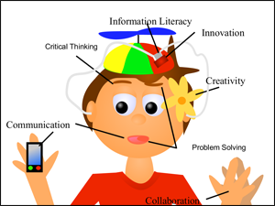
Elementary School Media Center
This is the area I am most familiar with as I have been employed in a public school elementary media center for the past year. It is fun and rewarding but a lot of work- a librarian is more than someone who just checks in or out books, as seen by the picture below. I am planning on getting my school library certification.
Image Source: http://columbuspublicschools.org/lostcreek/wp-content/uploads/sites/5/2014/06/4cs.png

Slide 3
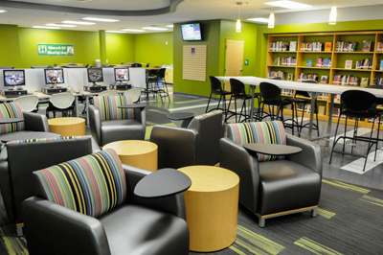
High School Media Center Coordinator
With the high school media center becoming more of a collaborative area, it has become an area that appeals to me, and so again, I will be pursuing my school certification. It is great to see school libraries finally following the trend of technology. The picture to the right shows a high school library that I would love to work at.
Image Source: http://www.nashvillechamber.com/sf-images/default-source/blog-photos/hillwood-library-080812.jpg?sfvrsn=0

Slide 4
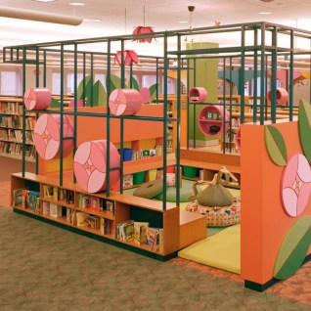
Public Library Children’s Librarian
Now what kid wouldn’t want to go to the library if they had this contraption to play and read in? If I don’t get a full-time job in a school setting after I complete my MLIS than I would really want to become a public library librarian in the children’s area. I think the teacher in me is what makes it so appealing to me to work with young children.
Image Source: http://www.redboxworkshop.com/media/portfolio/childrens-libraries/evanston-public-library/childrens-library/evanston-childrens-library-007.jpg

Slide 5
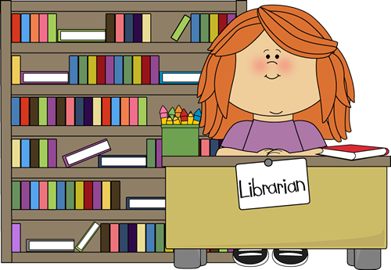



Thank you!
http://content.mycutegraphics.com/graphics/reading/dog-reading.png
http://content.mycutegraphics.com/graphics/school/classroom-librarian.png
So those are my options and what I have in mind for my career goals once I complete my MLIS degree. I hope you enjoyed my brief power point. Thank you.
http://www.clipartheaven.com/clipart/education_&_schools/classroom_&_activities/library_2.gif
http://www.clipartlord.com/wp-content/uploads/2014/03/library.png

